Slide 1
Protein folding

Slide 2
The polypeptide chains that make up proteins have thousands of atoms and hence millions of possible inter-atomic interactions.
The spontaneous self-assembly of protein molecules with huge numbers of degrees of freedom into a unique three-dimensional structure that carries out a biological function is perhaps the simplest case of biological self-organization.
The folding of larger proteins is also often facilitated by `molecular chaperones’ which prevent improper protein aggregation

Slide 3
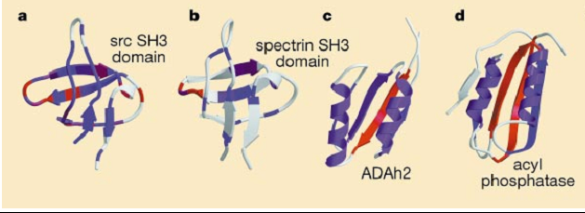
Dependence of folding mechanisms on topology
Structures of the
A: SH3 domains of src
B: Spectrin
C: The structurally related proteins Adah2;
D: Acyl phosphatase
the colors code for the effects of mutations on the folding rate. Red, large effect ; magenta, moderate effect; and blue, little effect
Contd..

Slide 4
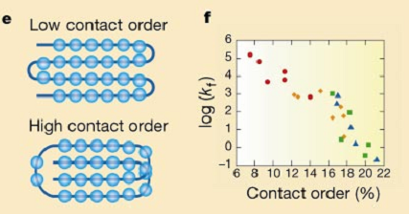
Correlation between contact order and folding rate (k_{f})
The relative contact order is the average separation along the sequence of residues in physical contact in a folded protein, divided by the length of the protein.
Circle: Helical Protein; Square: beta sheet; triangular: both helix and sheet

Slide 5
Analysis of mutation and protein folding
Mutations in regions that make stabilizing interactions in the transition state ensemble slow the folding rate, whereas mutations in regions that are disordered in the transition state ensemble have little effects.

Slide 6
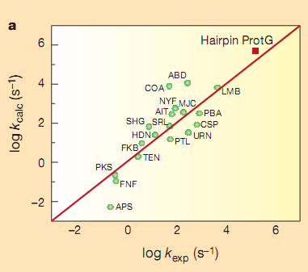
Prediction of protein-folding mechanisms
The accuracy of their prediction by plotting computed folding rates (k_{calc}) against experimentally measured rates (k_{exp}).

Slide 7
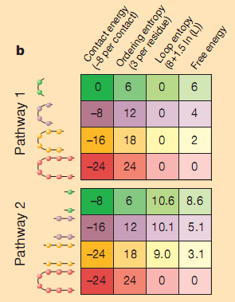
Different pathway involved in folding
beta-hairpin has two possible paths to the
native state, beginning at the hairpin (pathway 1) or at the free ends (pathway 2; ordered residues only are indicated; L is loop length)

Slide 8
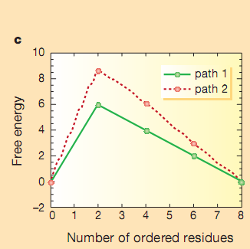
Ordered residues and free energy
Plotting the free energy as a function of the number of ordered residues shows that the transition state for both pathways consists of configurations with two of the residues ordered.

Slide 9
Terms and their uses
Loop entropy
The entropy lost upon bringing together two residues of a polymer within a prescribed distance. For a single loop, the entropy varies logarithmically with the number of residues N in the loop
where k_{B} is Boltzmann's constant and α is a coefficient that depends on the properties of the polymer. This entropy formula corresponds to a power-law distribution for the probability of the residues contacting.
Order Entropy:
The entropy change of a system at temperature T absorbing an infinitesimal amount of heat δq is given by

Slide 10
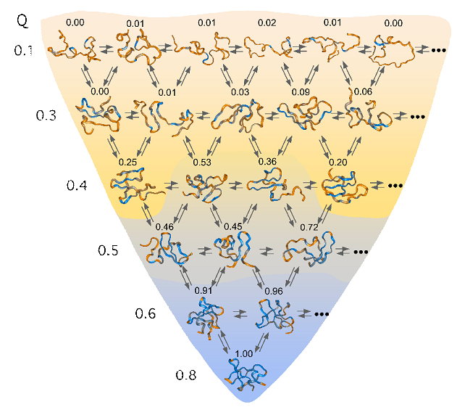
A schematic representation of the ordering of protein structures as they descend a funneled energy landscape.

Slide 11
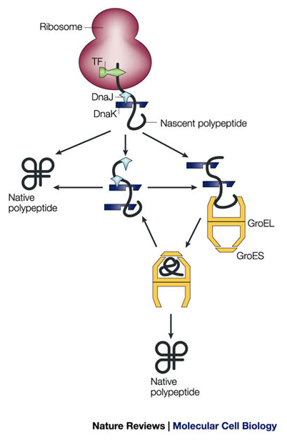
Pathways of chaperone-mediated protein folding in the cytosol
Nascent polypeptide chains are met by trigger factor (TF) as they emerge from the ribosome. The 70-kDa heat-shock protein DnaK, which is stimulated by its J-domain co-chaperone DnaJ, also binds nascent polypeptides. Newly synthesized polypeptides can fold spontaneously or can be assisted by DnaK. Alternatively, they can be passed to the GroEL–GroES chaperonin system for final folding, and, in some cases, might again interact with DnaK.

